Slide 1



Normalizing Course Play
Bear Carlson, Ryan French, Marty Knauf, Ben Metzger

Slide 2
Executive Summary
Hole Clusterings: Submitted 8 clusterings to evaluation team based off par, yardage, and average score. Best Tukey norm of 0.58.
Difficulty Model: Used public PGA course scorecard data as variables in a multiple linear regression with R² of 0.87 to predict scores.
College Adaptation Tool: Simplified PGA model to allow for any course in the country, R² of 0.66. Allows amateurs to benchmark their scores against PGA players, and easily adaptable by adding handicaps.

Slide 3
Meet the Team
Bear Carlson: Systems Engineer, 4th Year
Hometown: Katonah, NY
Skills: RStudio, Python, Excel, a stellar golfer
Ryan French: Systems Engineer, 4th year
Hometown: Virginia Beach, VA
Skills: R, Java, Excel, above average mini golfer
Marty Knauf: Mechanical Engineer, 4th Year
Hometown: Vienna, VA
Skills: Excel, RStudio, CAD, below average golfer
Ben Metzger: Systems Engineer, 3rd Year
Hometown: Richmond, VA
Skills: Python, Excel; poor golfer

Slide 4
Project Goals
Question: How do we help normalize success metrics based on course characteristics?
Three approaches:
Clustering holes
Shotlink Hole Data: Average score relative to par or average number of strokes per hole?
Test to see if our clusterings perform well in the Gerin-Bugg Algorithm™
Downloading data on each course
External hole data
Need to normalize for player quality playing on holes
Take the USGA course and slope rating to create an overarching difficulty characteristic

Slide 5
From Then To Now
Cluster holes based on Shotlink Hole Data
Download data on each course to for course normalization
Take the USGA course and slope rating to create an overarching difficulty characteristic
Used three factors to create clusterings graphically and with k-means
Created a multi-linear regression model based on professional data to normalize courses
Developed a tool to help collegiate players compare themselves to professionals

Slide 6
Hole Clusterings
Hypothesis: We can create simple, distinct clusters of holes based on easily accessible hole data

Slide 7
End Goal
Hole Clusterings
Evaluation Tool
Go For Green Classification Tree
Recommend Drills

Slide 8
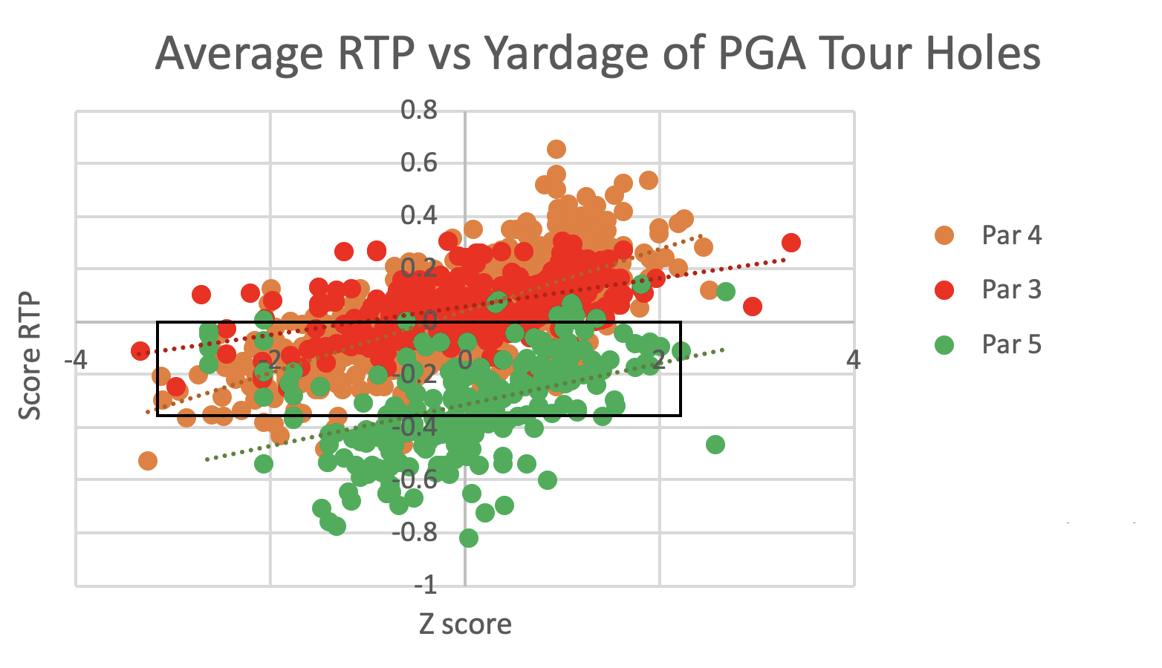
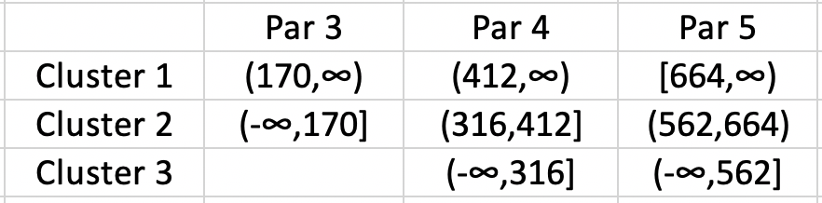
Clustering 1/3: 3 Manual Clusters
Clustered based on visualizing
Result statistics between 0.2-0.4
1
2
3

Slide 9
Clustering 2/3: 8 Manual Clusters
Clustered based on visualizing
Tukeynorm: 0.275
3
1
6
2
4
7
5
8

Slide 10
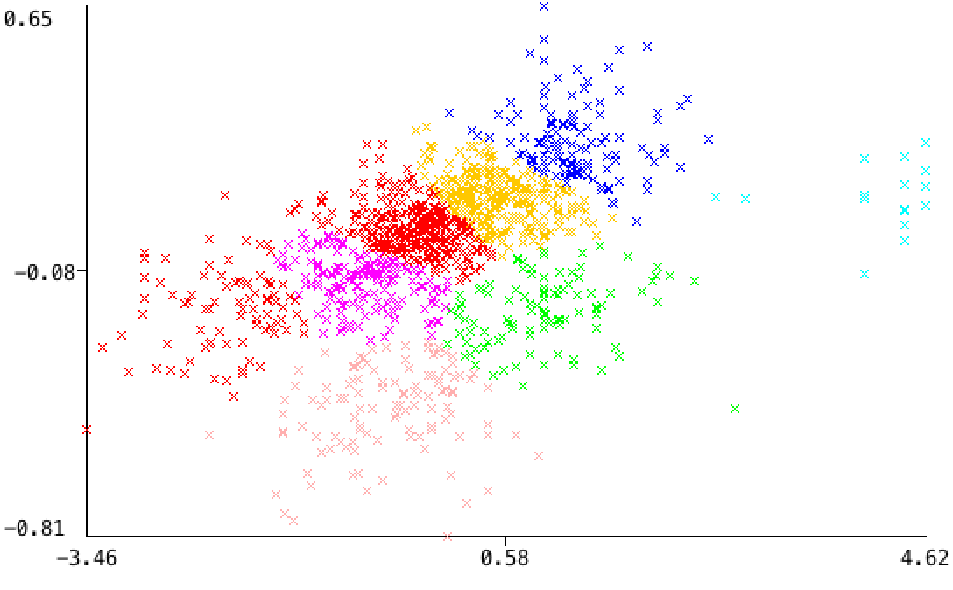
Clustering 3/3: K-Means
Using weka and R to cluster with K-Means
Submit to evaluation tool

Slide 11
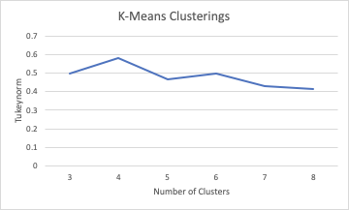
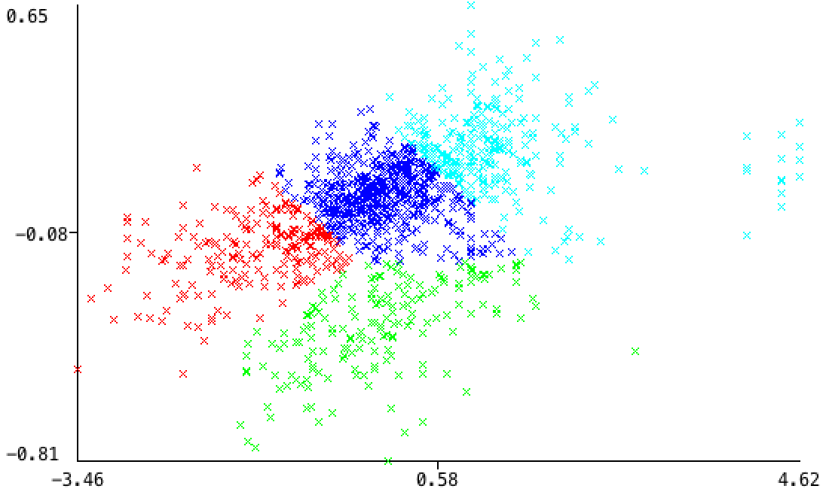
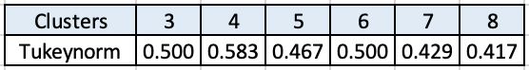
K-Means Results
4 Clusters

Slide 12
Normalizing Performance
Hypothesis: We can create a model that takes into account multiple aspects of a golf course and outputs a predicted score to normalize performance across all courses of different difficulties

Slide 13
Data Walkthrough: Difficulty Model
Data Sources:
Shotlink
USGA/PGA Tour
BlueGolf
Cleaning Process:
Found average round score for every round of every pga tour event
Aggregated this across all four rounds for all three years of data
Normalized each tournament for strength of field (FedEx Cup ranking)
Acquired all course metrics from public sources
Compiled into a CSV file to be read into R

Slide 14
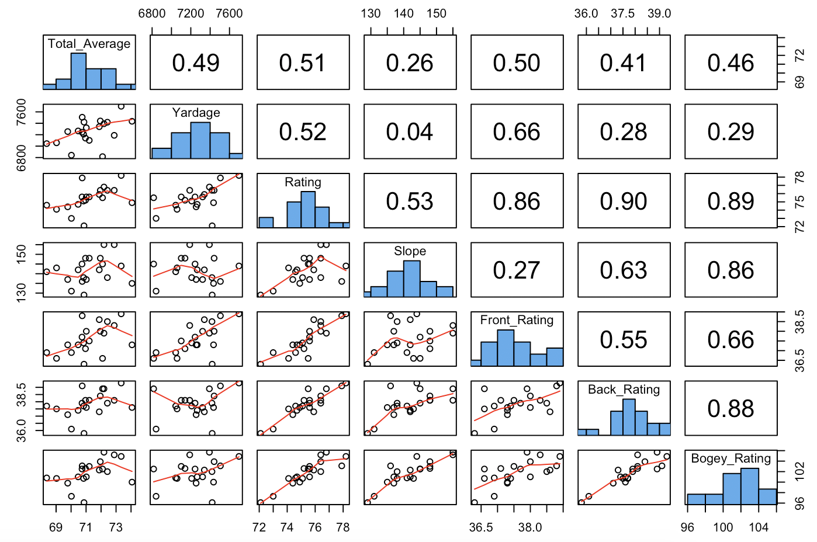
Factors with Significant Correlation to Difficulty
Significant and easily obtainable based on public information:
Course rating
Front nine rating
Yardage
Bogey rating
Back nine rating
Course slope
Front nine slope
Back nine slope
Par 3 average length
Par 4 average length
Par 5 average length

Slide 15
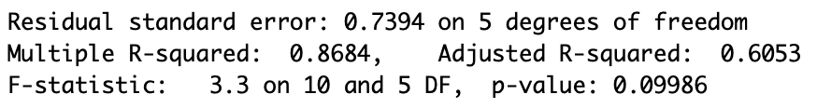
PGA Tour Model
Multiple Linear Regression Model to predict average score by a PGA Tour player
Dependent Variable: Average tournament round score
Independent Variables: Yardage, Course rating, Course slope, Front nine rating, Front nine slope, Back nine rating, Back nine slope, Bogey Rating, Par 3 average length, Par 4 average length, Par 5 average length
Performance:

Slide 16
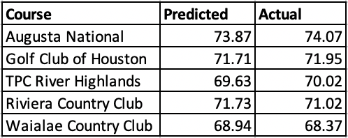
PGA Tour Model Prediction
Divided full data set into training and testing data sets
Used stratified random sampling

Slide 17
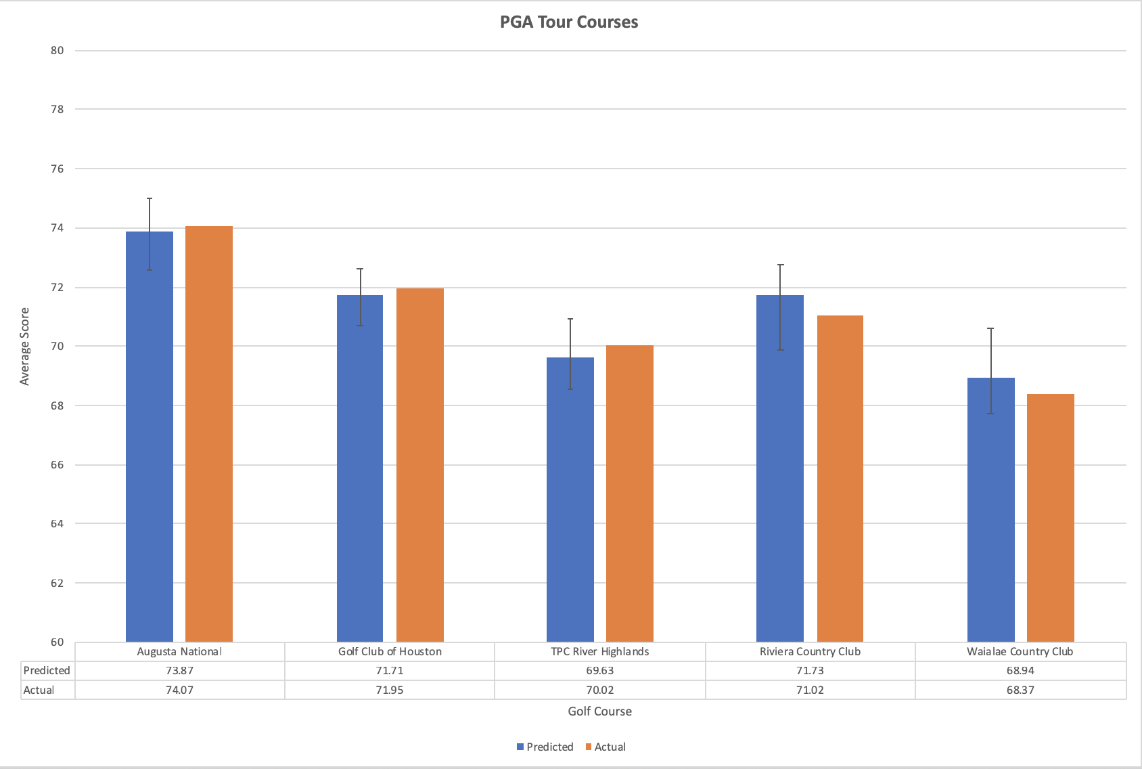

Slide 18
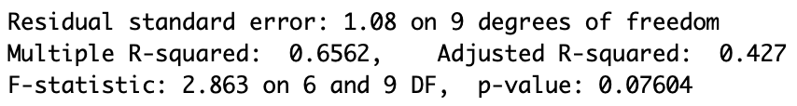
College Adaptation Tool
Use simplified version of the PGA Tour Prediction Model to allow for greater ease of use for college athletes and coaches
Dependent Variable: Average tournament round score
Independent Variables: Yardage, Course rating, Course slope, Par 3 average, Par 4 average, Par 5 average
Performance:

Slide 19
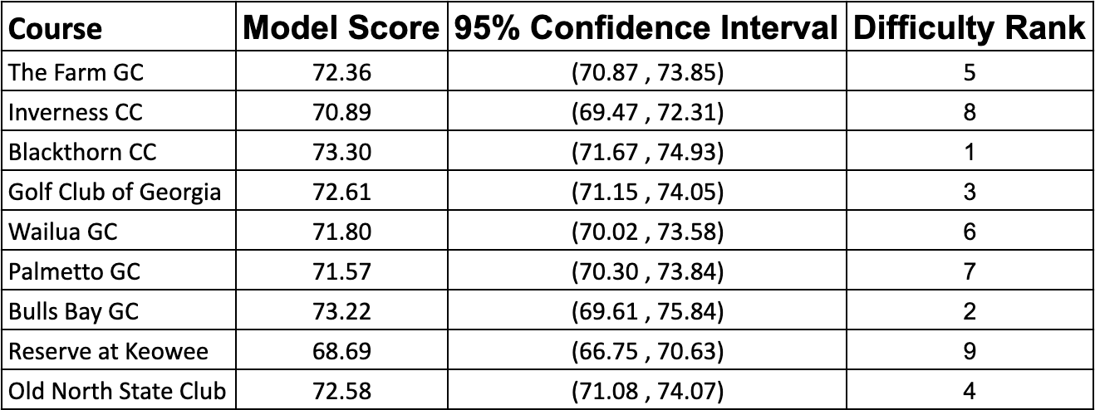
UVA Golf Schedule
Acquired independent variables for courses that UVA has played
Ran 9 courses through the college adapted prediction model
Ranked courses by difficulty

Slide 20
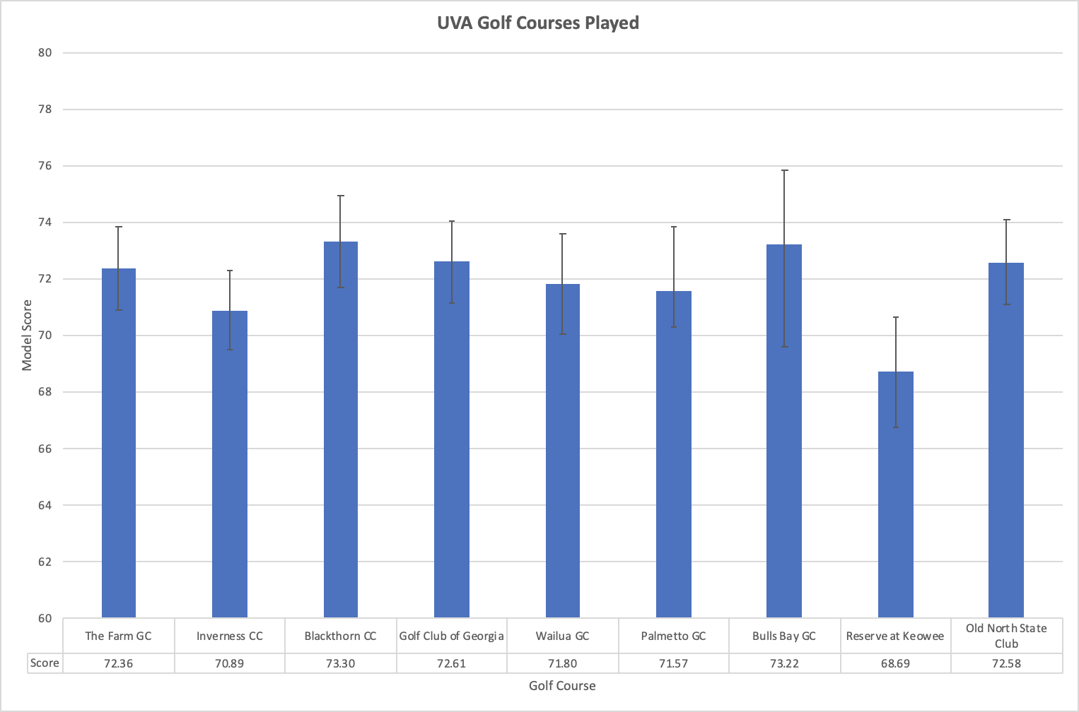

Slide 21
Using Model to Compare Play at College Level
The difficulty model will output an average score for each golf course a player plays when given the proper input variables
A player can then compare their score to that average score to obtain a specific differential
Whichever differential is lower is the course where the player played best
Ex.
Shot 74 at Inverness where average is 70.89 (Differential = 3.11)
Shot 75 at Bulls Bay where average is 73.22 (Differential = 1.78)
The player played better at Bulls Bay than at Inverness even though their score was higher
Coaches can use average of all players differentials to compare performance between players

Slide 22

PGA Tour Benchmarking
PGA Tour Model will predict what the average PGA Tour player will shoot on any given golf course
Very valuable to aspiring pros to see how they match up in terms of scoring on any given golf course
Easy for a player to use as they only need easily accessible metrics
Gives college players a realistic view of how they would compare to upcoming professionals, giving them motivation to improve specific aspects of their games while still in college

Slide 23
Questions?

